Slide 1
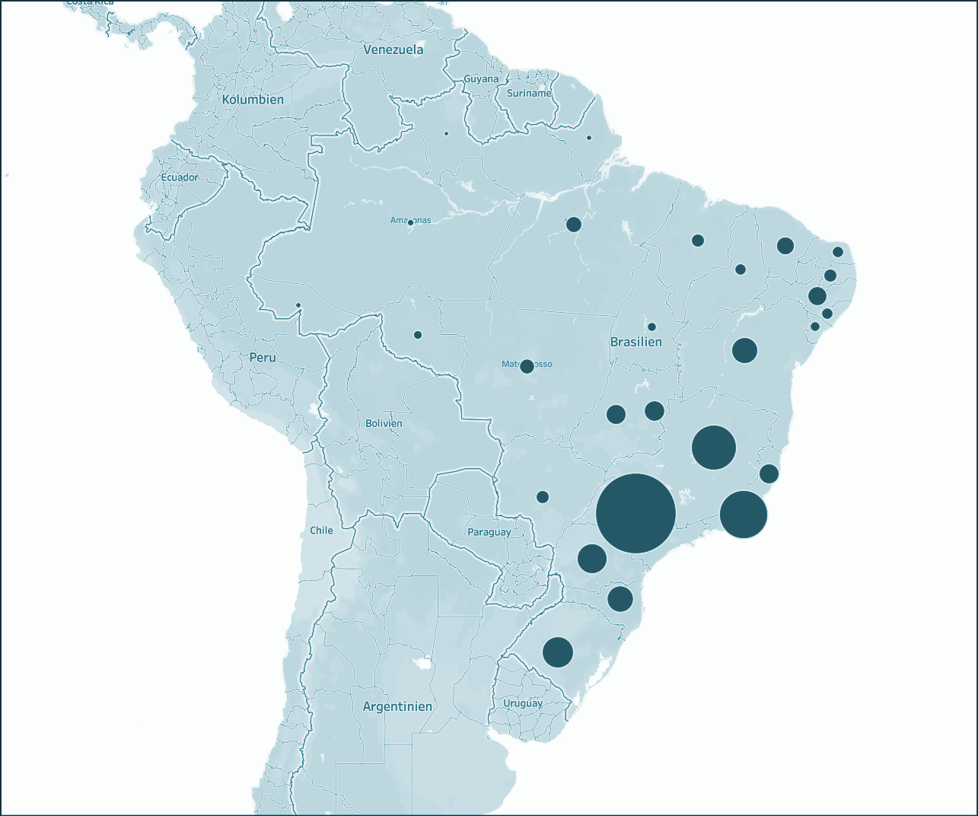
Strategic recommendation
Strategic
recommendation
ENIAC

Slide 2
Motivation
Strategic recommendation
Eniac is exploring an expansion to the Brazilian market
Magist: a Brazilian service company that offers a centralized order management system
Strategic
recommendation
ENIAC
Shall we sell high-tech via Magist?
Data-driven decision based on analysis of Magist dataset

Slide 3
Motivation
Eniac (April 2017 – March 2018):
Revenue: €14 M
Avg monthly revenue: €1,17M
Eniac is exploring an expansion to the Brazilian market
Magist: a Brazilian service company that offers a centralized order management system
Strategic recommendation
Strategic
recommendation
ENIAC
Shall we sell high-tech via Magist?
Data-driven decision based on analysis of Magist dataset

Slide 4
Strategic recommendation
Magist: a good fit for apple products?

Slide 5
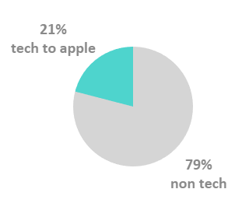
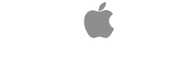
Apple-compatible products* sold
through Magist
79%
21%
other products
*Audio, cine_photo, computers, computers accessories,
consoles, electronics, pc_gamer, smart watches, phones

Slide 6
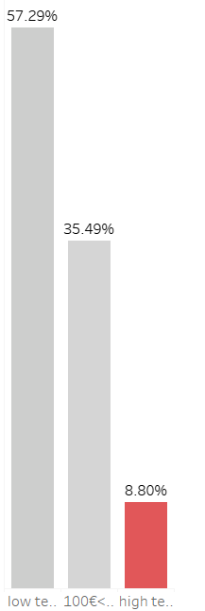
Apple-compatible products* sold
through Magist
Low tech
55.7%
(0,€100)
79%
21%
Med. tech
35.5%
other products
(€100,€540)
High tech
8.8%
>€540
High-tech sellers are only the ~9%
*Audio, cine_photo, computers, computers accessories,
consoles, electronics, pc_gamer, smart watches, phones

Slide 7
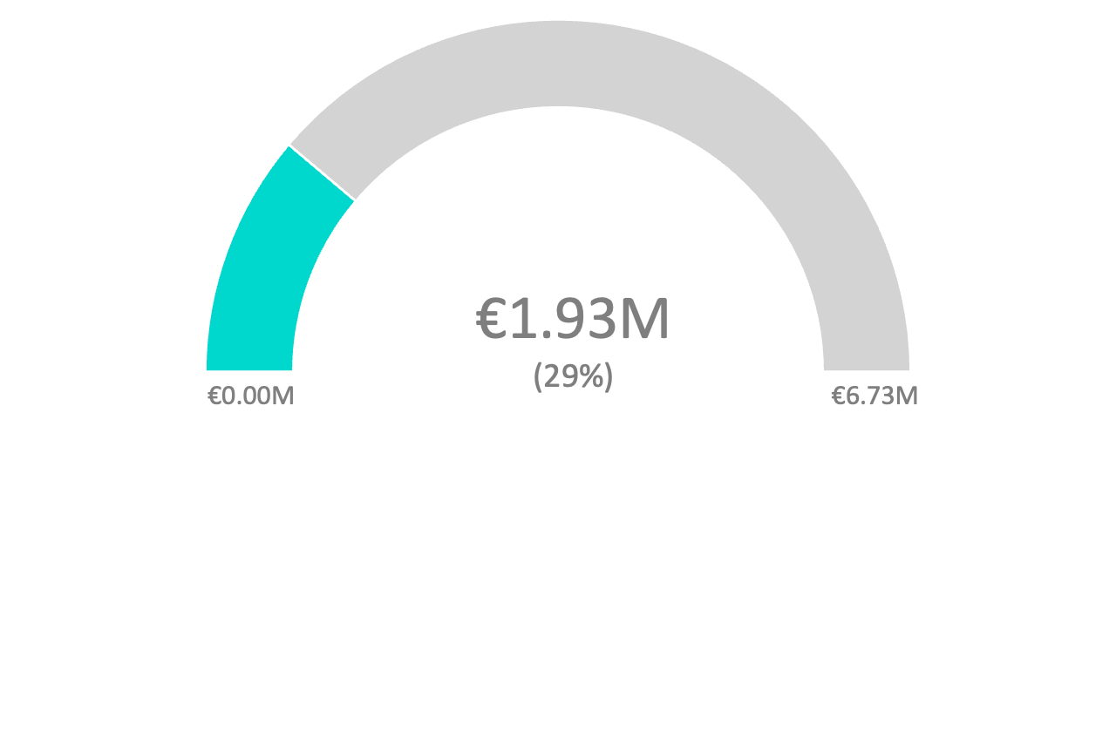
Apple-compatible products* sold
through Magist
total
revenue
sellers
revenue
79%
21%
other products
April 2017 - March 2018
Despite apple-compatible products are the 21%, they constitute almost the 30% of the total revenue
*Audio, cine_photo, computers, computers accessories,
consoles, electronics, pc_gamer, smart watches, phones

Slide 8
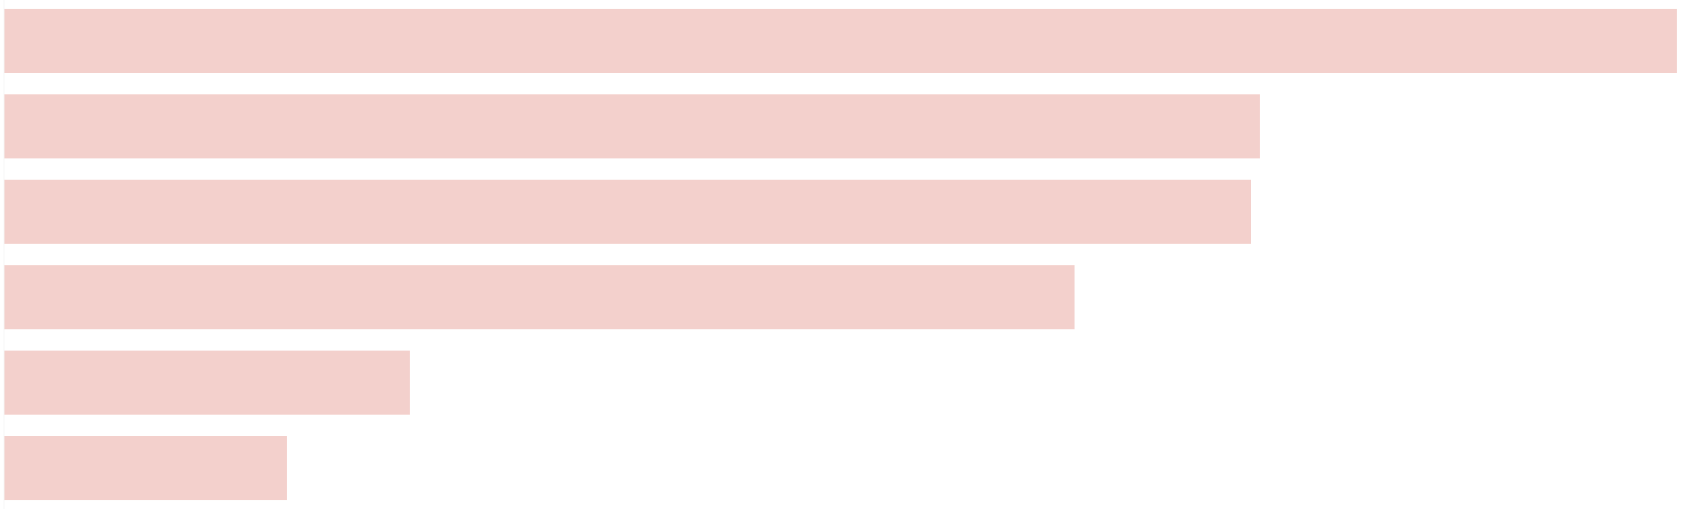
Top apple-compatible products sellers
April 2017 - March 2018
total
revenue
€178k
sellers
seller 1
revenue
seller 2
€134k
seller 3
€133k
seller 4
€114k
seller 5
€43k
April 2017 - March 2018
The highest revenue of a tech seller on Magist is €178K. In the same period Eniac’s revenue was €14M
Despite apple-compatible products are the 21%, they constitute almost the 30% of the total revenue

Slide 9
Strategic recommendation
Magist service assessment

Slide 10
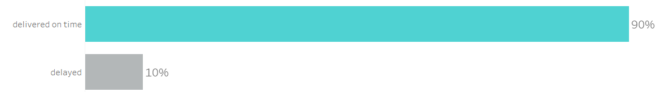
Are deliveries on time?
Delivery timings in April 2017 - March 2018
on-time
90%
delayed
10%
90% of Magist deliveries are on-time with an average delivery-time of 12 days, way faster than the average Brazilian one of 20 days*.
*https://www.statista.com/statistics/1117196/delivery-time-e-commerce-brazil/

Slide 11
78% of customers’
reviews are positive
⭑⭑⭑⭑(⭑)

Slide 12
Strategic recommendation
Conclusion

Slide 13
Pros
Cons
Magist:
Magist:
Performs well in tech sales
Delivers fast
Satisfies its customers
Is not strong in high-tech
Is not profitable
21% of the products are compatible-apple devices, with 29% contribution to the total revenue
Only 8.8% of the tech products are high-tech while 91.2% are medium to low tech
90% of the deliveries arrived on time, 8 days faster than the average delivery time in Brazil
Max revenue of top Magist tech-sellers is €178K. Our revenue is €14M
78% of customers reviews are positive (4- 5 stars)

Slide 14
Pros
Cons
Magist:
Magist:
Performs well in tech sales
Delivers fast
Satisfies its customers
Is not strong in high-tech
Is not profitable
Data suggest the profit would be minimal compared to our current performance.
However, Magist is a valuable delivery tool and we suggest to repeat the same analysis in the future on new data and postpone the decision.
21% of the products are compatible-apple devices, with 29% contribution to the total revenue
Only 8.8% of the tech products are high-tech while 91.2% are medium to low tech
90% of the deliveries arrived on time, 8 days faster than the average delivery time in Brazil
Max revenue of top Magist tech-sellers is €178K. Our revenue is €14M
78% of customers reviews are positive (4- 5 stars)

Slide 15
APPENDIX

Slide 16
Top apple-compatible products sellers
April 2017 - March 2018
seller 1
€178k
seller 2
€134k
seller 3
€133k
seller 4
€114k
seller 5
€43k

Slide 17
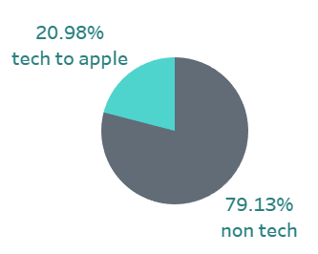
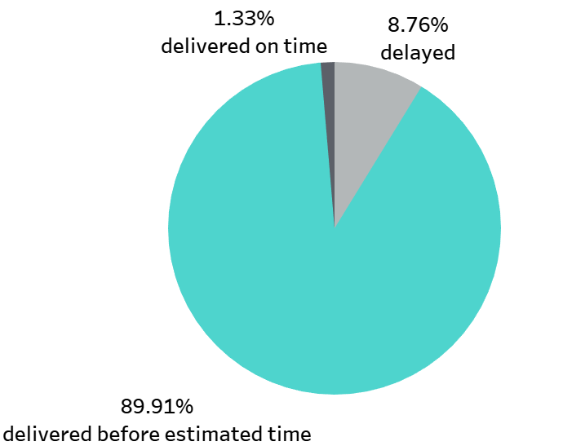
 | Key question | Explanation | Visualization
Title + Intro | Why do we need to hire an external company in Brazil? | Bigger picture. What’s our issue how do we solve it. | TEXT
Is this relevant for us? | What percentage of tech products does Magists have? | This helps us characterizing the company we’re analyzing (e.g. if they sells 1% of tech and 99% of food we shouldn’t hire Magist)
 |  | Analyzing how much tech sellers earn through Magist gives us information of how much we could earn too. | Gauge chart
Company characterization | Are Magist customers satisfied? |  | Percentage
 | Are deliveries punctual? | Find relations between product and delay/on time | Pie chart
Conclusion | What should we choose and why? |  | TEXT
Here are some numbers that will help you understand Eniac’s scope (data from April 2017 – March 2018):
Revenue: 14 million €
Avg monthly revenue: 1,17million €
Avg order price: 710 €
Avg item price: 540 €
Core
part

Slide 20
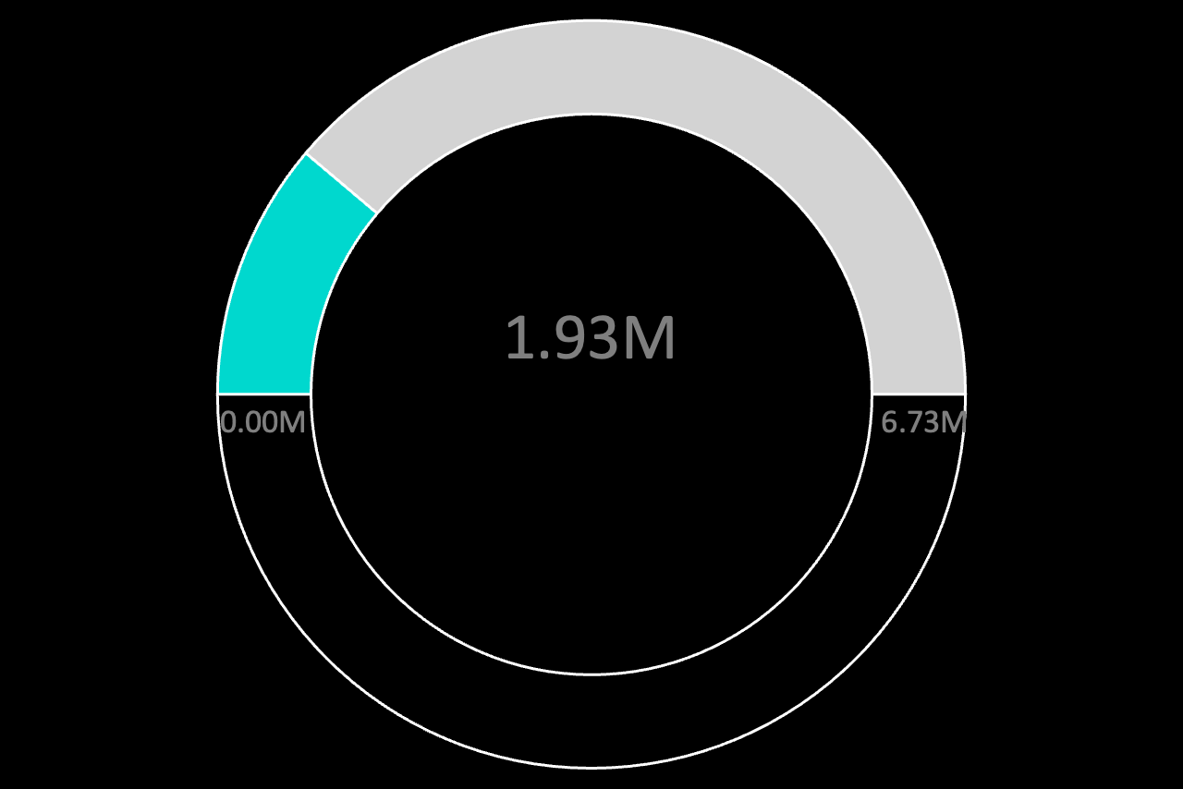
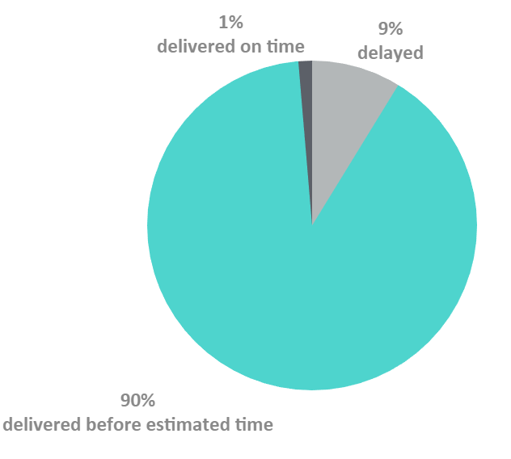

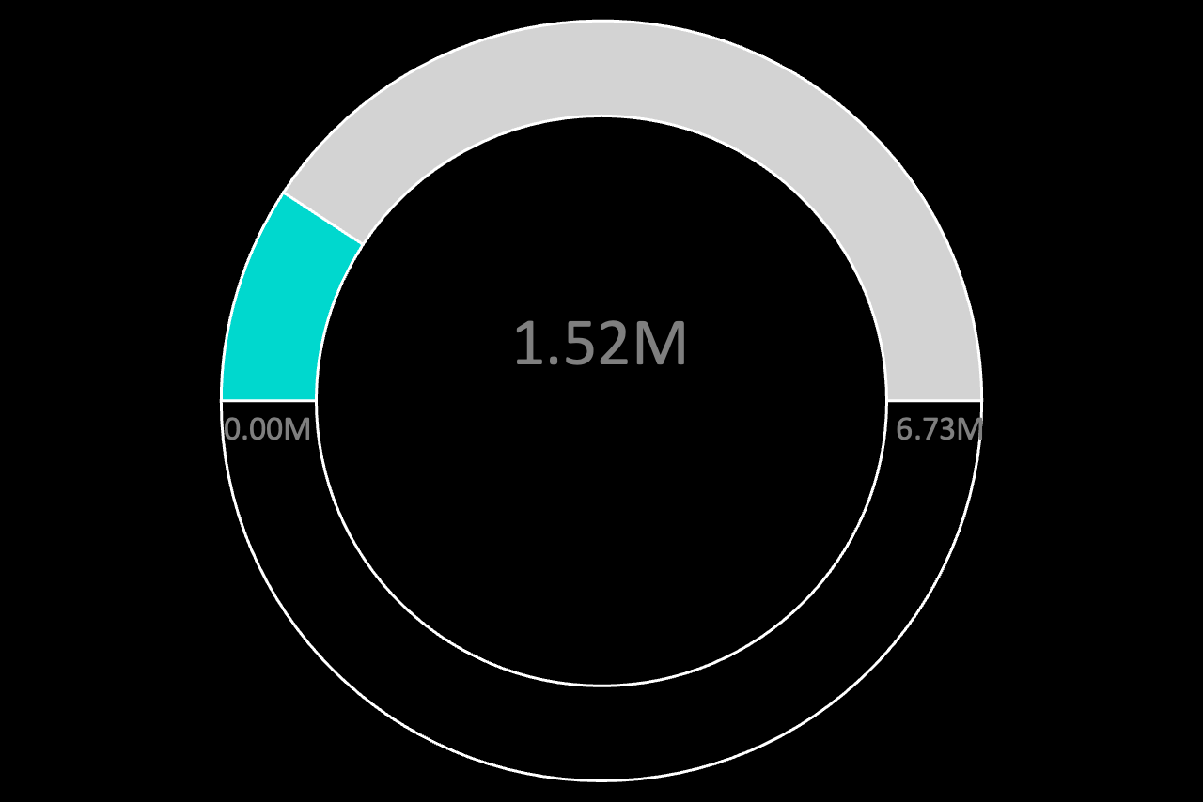


Slide 21
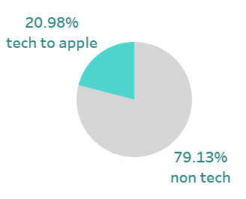
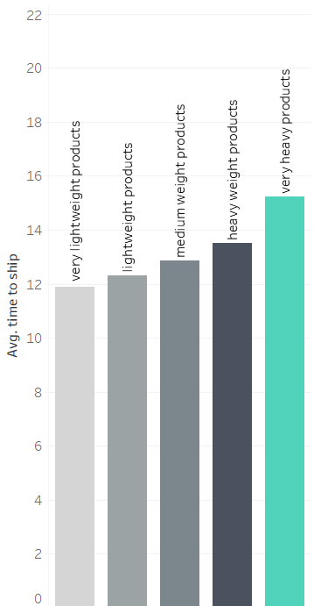
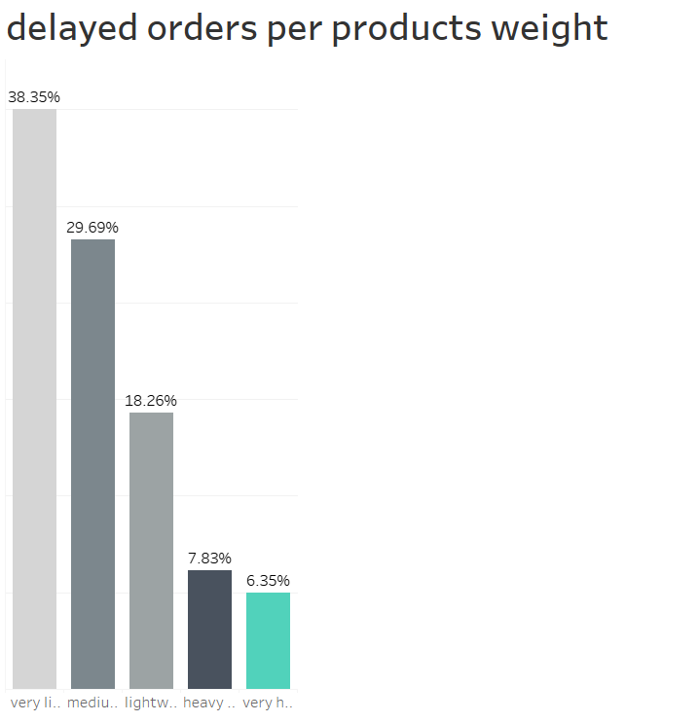
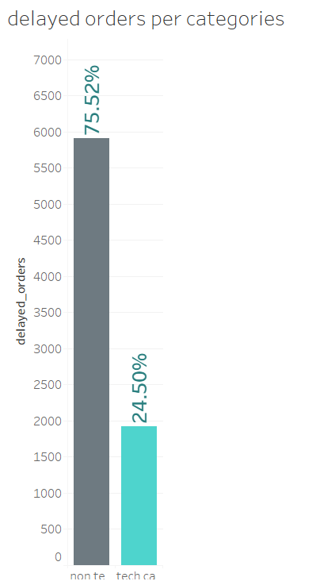
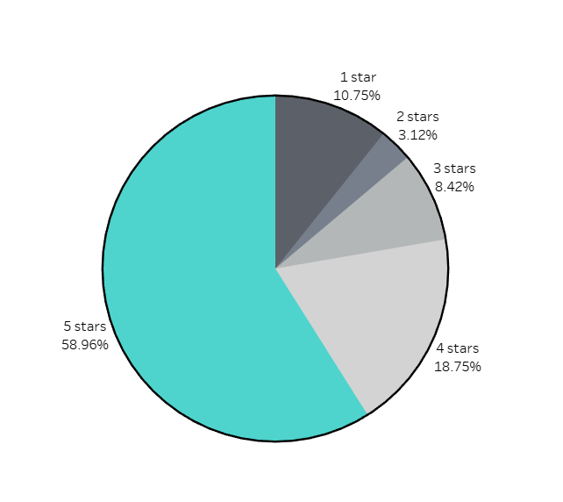
Sarra’s plots

Slide 22
Customers are satisfied
80%

Slide 23
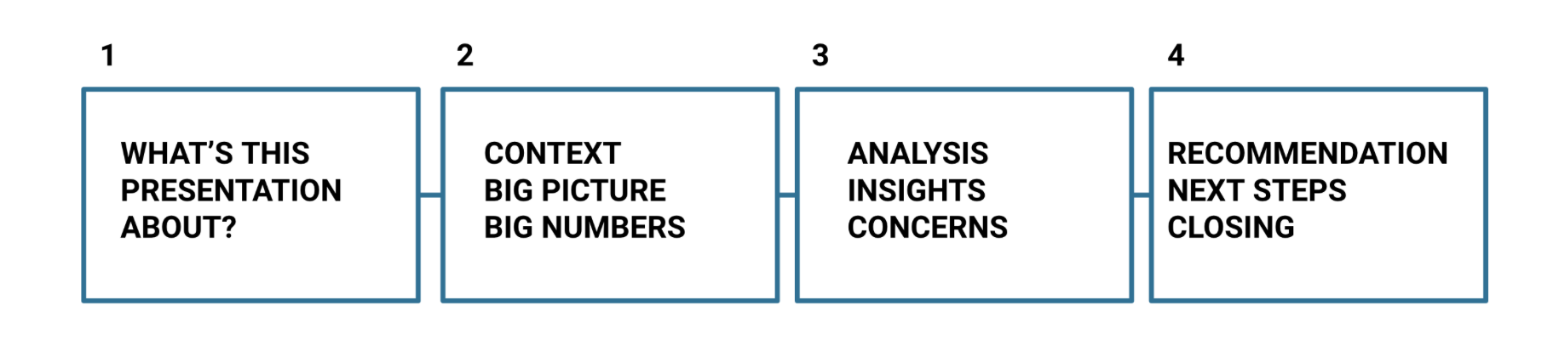

Slide 24


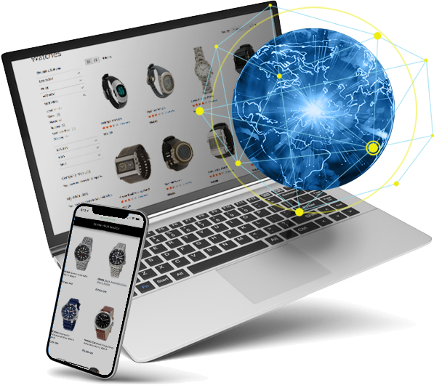
Agenda
High_end tech products
Delivery time
conclusion
is the delivery in MAGIST fast enough ? how much time does it take for the order to be delivered ?
will it be profitable to work with MAGIST ?
is MAGIST a good fit for high_end tech products?

Slide 25
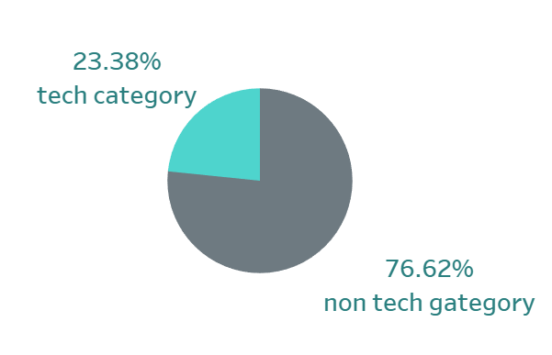
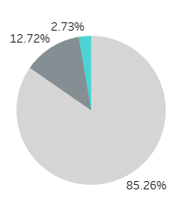
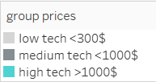
is MAGIST a good fit for high_end tech products?
Between september 2016 and september 2018 , 23% from sales in MAGIST is tech category products .
also the tech products compatible to apple are 20,98 % from sales .
here we can see the the price distribution of tech products compatible to apple in sales. high tech products are 2,7 % .

Slide 26
is MAGIST a good fit for high_end tech products?
Between september 2016 and september 2018 , 23% from sales in MAGIST is tech category products .
also the tech products compatible to apple are 20,98 % from sales .
here we can see the the price distribution of tech products compatible to apple in sales. high tech products are 2,7 % .

Slide 27
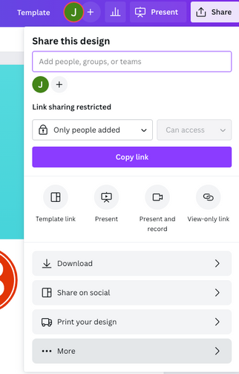

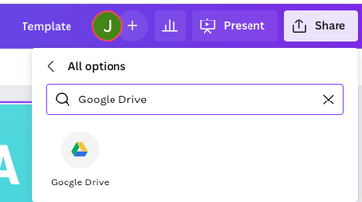
Download this presentation as
a Google Slide template in 3 steps
Click on the "Canva" button next to this presentation. Start editing your presentation. You may need to sign in to your Canva account.
Click on the "Share" button on the top right corner in Canva and click on "More" at the bottom of the menu.
Enter "Google Drive" in the search bar and click on the Google Drive icon to add this design as a Google slide in your G Drive. It will ask you to link your Google account to Canva the first time.

Slide 28


Add an Agenda Page
High_end tech products
is MAGIST a good fit for high_end tech products?
Delivery time
is the delivery in MAGIST fast enough ? how much time does it take for the order to be delivered ?

Slide 29





Add a Roadmap Page
Elaborate on the data you want to discuss.
Add a main point
Add a main point
Add a main point
Elaborate on what you want to discuss.
Elaborate on what you want to discuss.
Elaborate on what you want to discuss.
Add a main point
Add a main point
Elaborate on what you want to discuss.
Elaborate on what you want to discuss.

Slide 30
Add a Roadmap Page
Elaborate on the data you want to discuss.
Add a main point
Add a main point
Add a main point
Elaborate on what you want to discuss.
Elaborate on what you want to discuss.
Elaborate on what you want to discuss.
Add a main point
Add a main point
Elaborate on what you want to discuss.
Elaborate on what you want to discuss.

Slide 31
Add a Roadmap Page
Elaborate on the data you want to discuss.
YEAR | JAN | FEB | MAR | APRIL | MAY | JUNE | JULY | AUG | SEPT | OCT | NOV | DEC
Action Point
Action Point
Action Point
Action Point

Slide 32
Add a Roadmap Page
Elaborate on the data you want to discuss.
YEAR | MONTH 1 | MONTH 2 | MONTH 3 | MONTH 4 | MONTH 5 | MONTH 6
Action Point
Action Point
Action Point
Action Point

Slide 33


Write your topic or idea
Add a main point
Briefly elaborate on what you want to discuss.
Add a main point
Briefly elaborate on what you want to discuss.
Add a main point
Briefly elaborate on what you want to discuss.

Slide 34

Hello there!
I'm Rain, and I'll be sharing with you my beautiful ideas. Follow me at @reallygreatsite to learn more.

